Slide 1


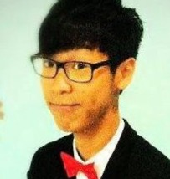
Sep is Rotaract Month
Rotary
Club of Macau
Speaker: Rotaractor Kammy Cheong
Topic: ‘Gather with Me’
Venue: Venetian Macao-Resort- Hotel
Room
Date: Sep 17 , 2015 (Thursday)
Time: 8:30pm – 10:00pm
Highlights: Kammy is RAC UMSU Community Service Director and President-Elect .
He will talk about a project which has won Galaxy Youth Achievement Award

